Slide 1
Secure Data Storage and Encryption using GnuPG
Group By: Bhargava Reddy Kikkura
Bharath Kumar Uppala
Hari Kiran Gaddam
Bharath Viswa Teja Vidya Charan Maddala
Rajaabinandhan Periyagoundanoor Gopa

Slide 2

Introduction on Database & MySql:
It is a collection of data that is organized and stored for efficient retrieval and management. It acts as a central repository for information, allowing users to store, manage, and retrieve data easily.
MySQL is one of the most popular and widely used relational database management systems (RDBMS). It is an open-source solution known for its speed, reliability, and ease of use.

Slide 3
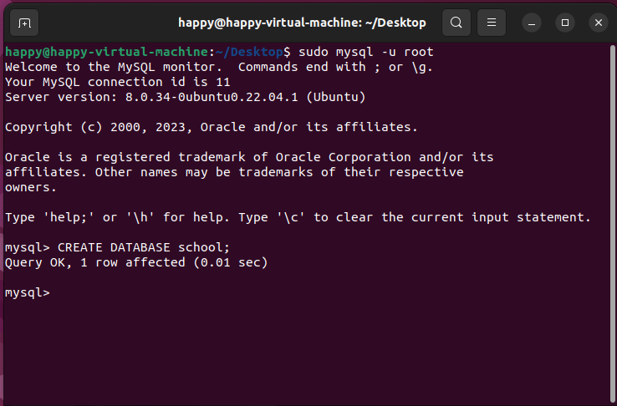
Logging into the root user in MySQL and creating a database: :

Slide 4
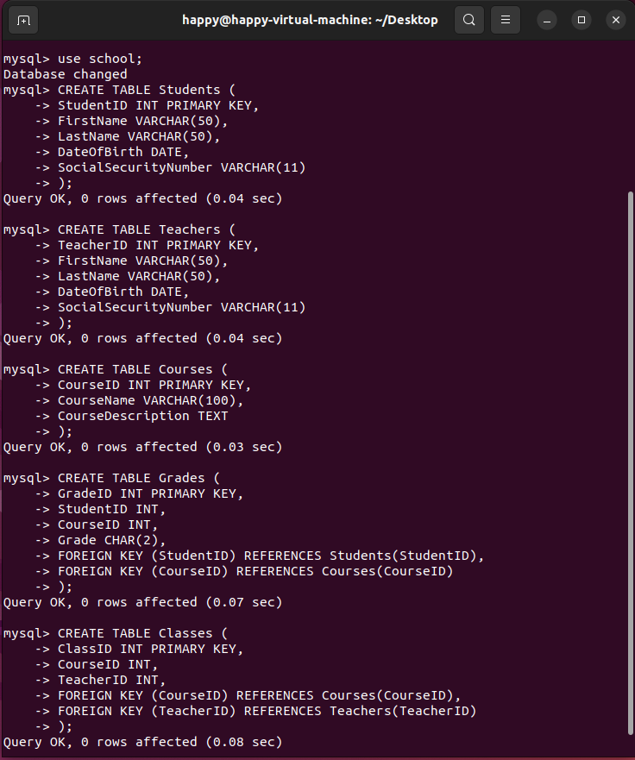
Creating a Tables in Database:

Slide 5
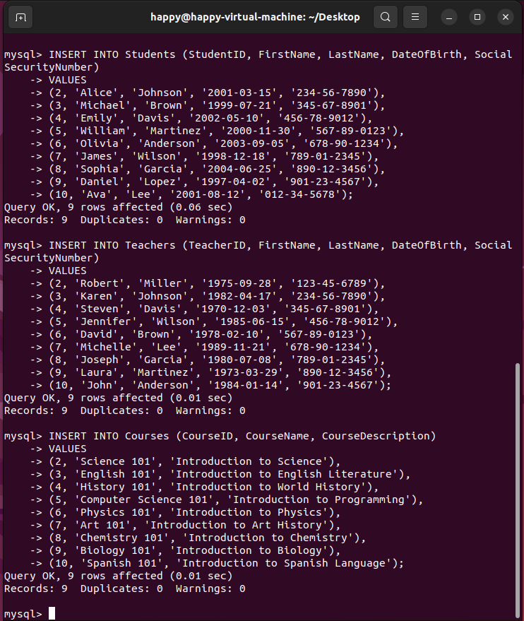
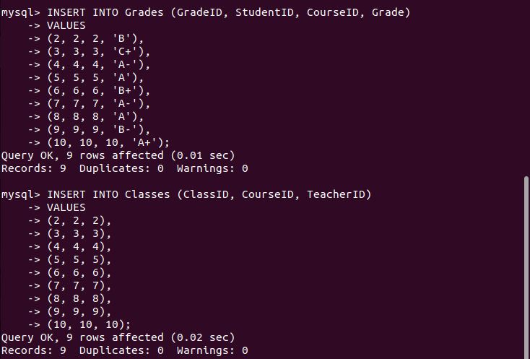
Inserting the data:

Slide 6
Creating User to School Database:
InInFFFBBBHBHJNNNN

Slide 7
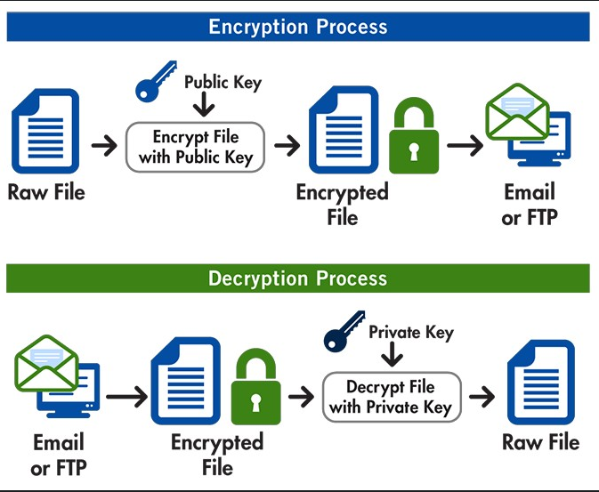
GPG Encryption Keys:
Securing and private digital communication starts with the creation of GPG encryption keys. A pair of keys can be created by users of GPG, or GNU Privacy Guard: a public key for encrypting communications and a private key for decrypting them.
Users must choose the key type and size, enter personal data, and create a passphrase to secure their private keys in order to produce GPG keys. After it is generated, the private key should be kept private, while the public key can be shared publicly.
These keys protect data in an increasingly linked and data-centric society by enabling digital signatures, encrypted email, and secure file sharing.

Slide 8
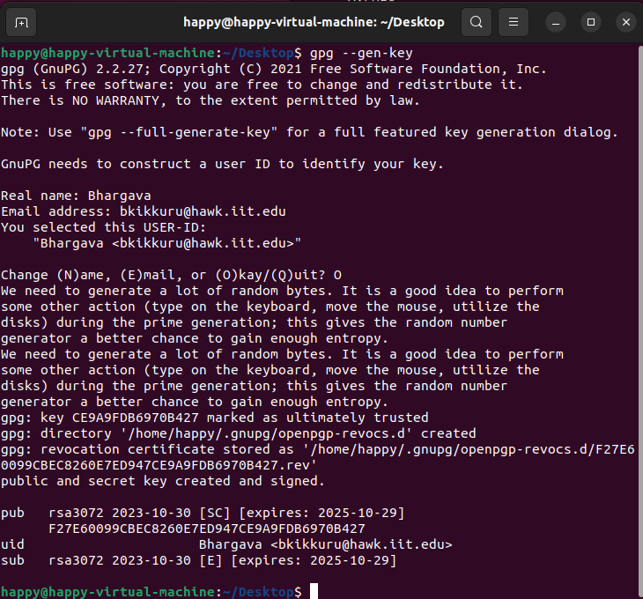
Setting up GPG

Slide 9
Exporting keys into different ASCII files.
Export by Using Public : Your public key is exported by this command and piped into a file called public_key.asc. By using the --armor option, you may be guaranteed that the output will be in ASCII armored format, which is a shareable plain text format. Command Used for Public: gpg --export --armor > public_key.asc Export by Using Secret Key: Exporting the secret key requires additional steps for security reasons. You should export your secret key to a separate file and protect it. Command Used for Secret Key: gpg --list-secret-keys

Slide 10

Encryption & Decryption Implementation:

Slide 11
Role of Encryption & Decryption:
Encryption:
Most Databases security techniques focus on controlling access passwords,, privileges, encryption Data.
There is much less focus on protecting Data.
Encryption is Increasingly being used to protect Data like Backups and Any Hard Drives which get stolen or lost.
Decryption:
Authorized users cannot access, view, or manipulate encrypted data without decryption. This is essential in many fields, including finance, healthcare, secure communication.
Sensitive data is kept private through decryption. Only those with the appropriate decryption keys (e.g., private keys) can unlock and read the protected data.
Certain encryption techniques, such as digital signatures, encrypt a data hash. In order to confirm that the data has not been altered during transmission, decryption is necessary

